Slide 1



Sales Analysis Reports
View in Power BI
Last data refresh:
9/16/2019 8:18:10 PM Central Standard Time
Downloaded at:
10/10/2019 3:53:22 PM Central Standard Time

Slide 2
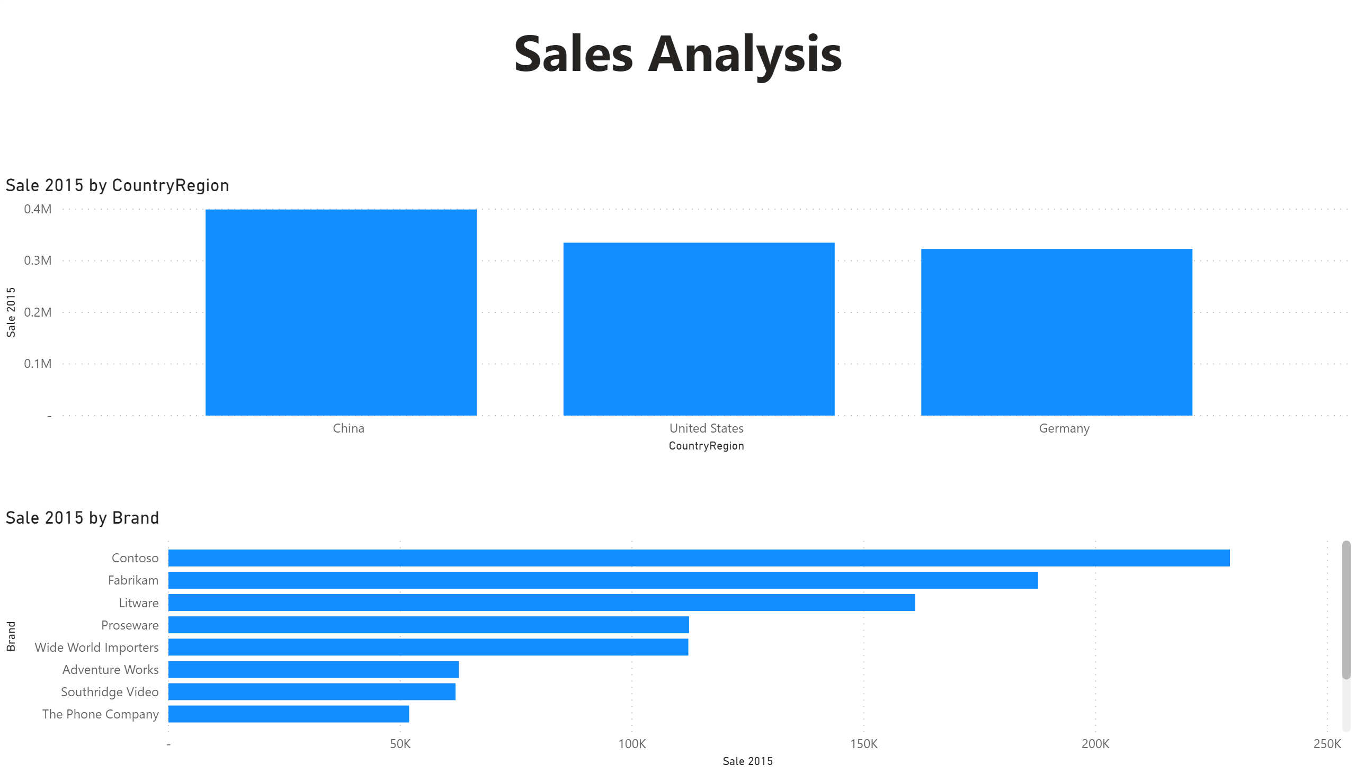

Slide 3
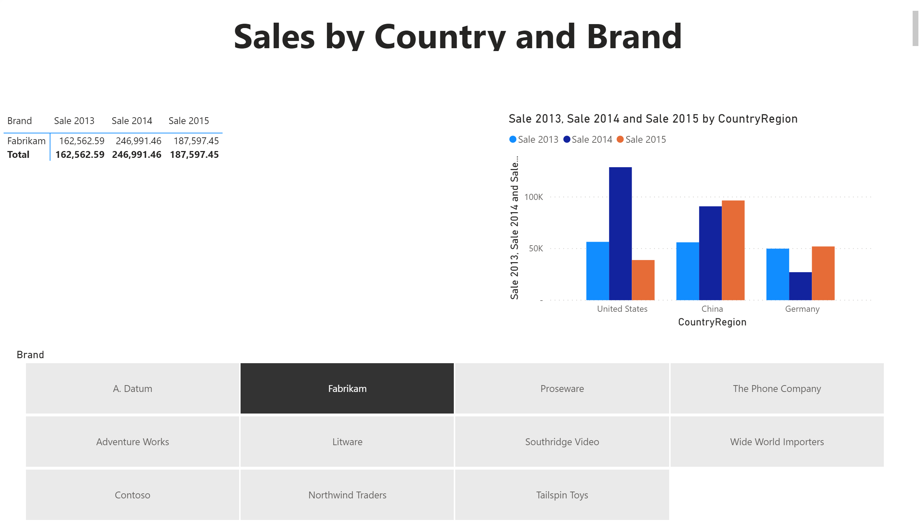

Slide 4
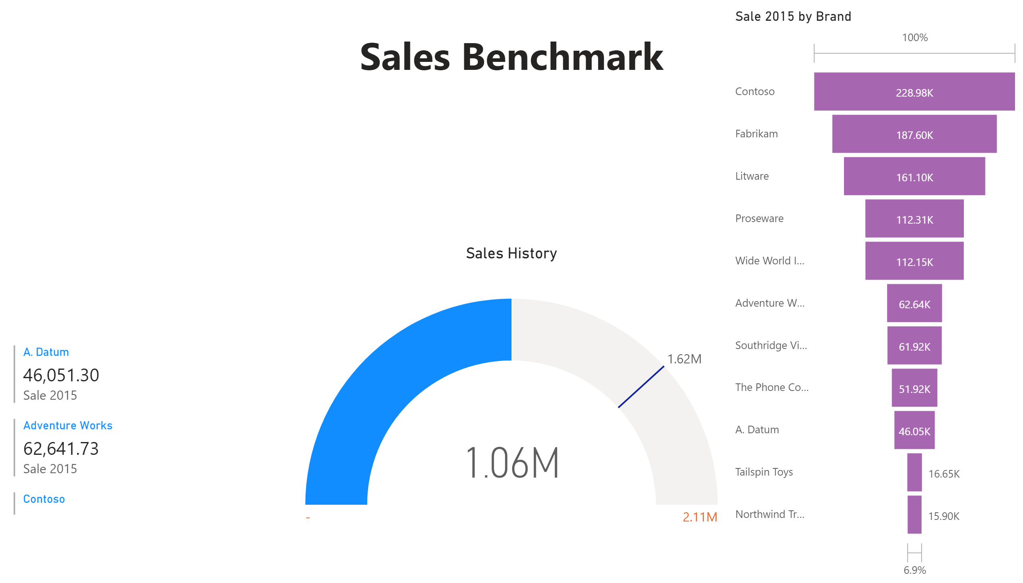

Slide 5
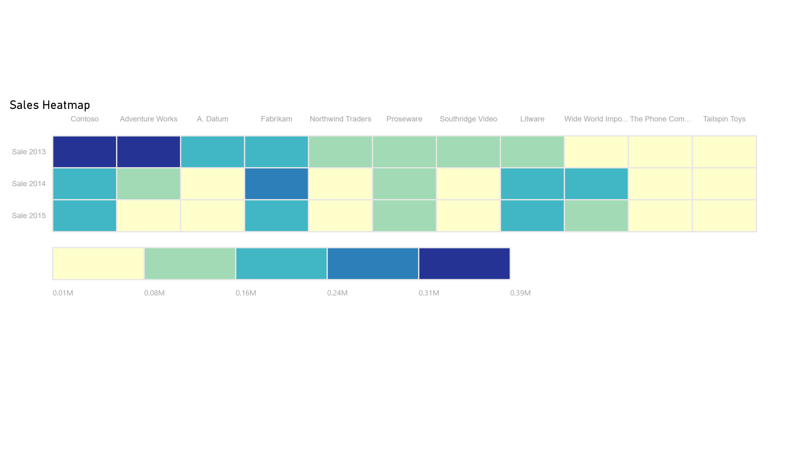

Slide 6
